Slide 1
Welcome to SHARC
Simulator for use in SHARing and Compatibility studies of wireless communication systems

Slide 2
Vectorization versus OOP
http://softwareengineering.stackexchange.com/questions/200346/object-oriented-vs-vector-based-programming
http://www.labri.fr/perso/nrougier/from-python-to-numpy/

Slide 3
Unit tests framework

Slide 4
Code style guide
This project adheres to:
PEP 8: Style Guide for Python Code
PEP 257: Docstring Conventions
Along with Style Guide, the following useful reading is suggested:
https://google.github.io/styleguide/pyguide.html
Example: naming
module_name, package_name, ClassName, method_name, ExceptionName, function_name, GLOBAL_CONSTANT_NAME, global_var_name, instance_var_name, function_parameter_name, local_var_name

Slide 5
Project-specific conventions
One class definition per file and encapsulated attributes
Place all your unit tests in tests/ directory
Power | dBm
Power spectral density | dBW/Hz
Frequency | MHz
Antenna gain | dBi
Attenuation (MCL, ACS, etc) | dB
Distance, height, etc | m
Angle | degree
Temperature | K

Slide 6


Project-specific conventions
Use Python 3.5 type hinting:
Read more about it:
https://blog.jetbrains.com/pycharm/2015/11/python-3-5-type-hinting-in-pycharm-5/
https://www.python.org/dev/peps/pep-0484/
def greeting(name):
return 'Hello, {}'.format(name)
def greeting(name: str) -> str:
return 'Hello, {}'.format(name)

Slide 7
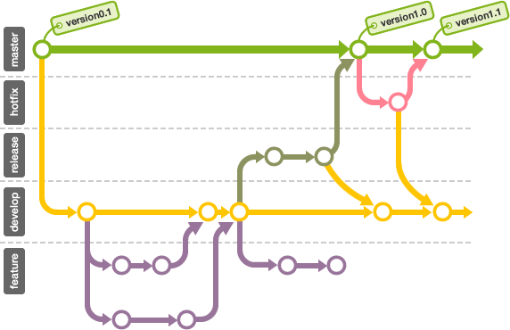
Repositories and branches
GitHub is hosting the source code and related documents
Learn more about Git and Git branching:
https://backlogtool.com/git-guide/en/
http://nvie.com/posts/a-successful-git-branching-model/

Slide 8
Project tracking
Work will be tracked using ASANA (or TRELLO??)
SCRUM-based?

Slide 9
Features to be implemented
Go to ASANA

Slide 10
AOB
How to calculate performance degradation of IMT?
Check e-mail from Tarcisio

